Slide 1

International Conference on Advances in Science, Technology & Interdisciplinary Innovations (ICASTII-2026)
On 24th-25th March 2026
Theme: Sustainable Innovation for a Smarter Future
Paper Title: Real Time Environmental Parameters Display
Paper ID: | ICASTII-2026-ENTC-355 | Track No: 6
Presenter Name: | Avantika K. Yerawar | Pranay V. Jadhao

Slide 2
Content :
Abstract
Introduction
Problem Statement
Proposed Solution
System Architecture
Components Used
Working
Conclusion
References

Slide 3

Abstract :
Environmental monitoring has become important due to increasing concerns about air pollution, climate change and human health.
Environmental parameters such as temperature, humidity, CO₂ concentration and dust particles directly affect living conditions.
ESP32-based systems provide a low-cost and flexible solution for real-time monitoring.
These systems integrate multiple sensors and display environmental data instantly using local display devices.

Slide 4
Introduction :
Environmental monitoring is essential for maintaining human health and ecological balance.
Rapid urbanization, industrialization and vehicular emissions have increased environmental pollution.
Continuous monitoring of parameters such as temperature, humidity, CO₂ and dust concentration is necessary.
Traditional monitoring systems are often expensive and complex.
Microcontroller-based embedded systems such as ESP32 provide an affordable and easy-to-use alternative for real-time environmental monitoring.

Slide 5
Problem Statement :
• Environmental conditions such as temperature, humidity, CO₂ concentration, and dust levels directly affect human health and environmental quality.
• Traditional environmental monitoring systems are often expensive, complex, and dependent on advanced infrastructure.
• Many existing systems do not provide continuous real-time monitoring or are difficult to deploy in resource-constrained environments.
• There is a need for a low-cost, simple, and efficient system that can monitor multiple environmental parameters in real time.

Slide 6
Proposed Solution :
• Develop a real-time environmental monitoring system using ESP32 and multiple sensors.
• Sensors such as DHT11, MQ-135, and dust sensors collect environmental data.
• The ESP32 microcontroller processes the sensor data and converts it into readable values.
• The measured parameters are displayed in real time using LCD or display modules.
• This system provides a low-cost, flexible, and easy-to-implement solution for monitoring environmental conditions.

Slide 7
System Architecture :
• Main components of system:
– Sensors
– ESP32 (Microcontroller)
– Processing Unit
– Display System
• Sensors collect environmental data.
• ESP32 processes signals and converts into readable values.
• Output is displayed on LCD or display module.
The system is modular, flexible and easy to expand based on requirements.

Slide 8
Components Used :
.
ESP32
Humidity Sensor
DHT11 Sensor
MQ Sensor (CO2)
Dust Particles Sensor
16×2 LCD Display (4-Bit Mode)
ACP & MDF Sheet

Slide 9
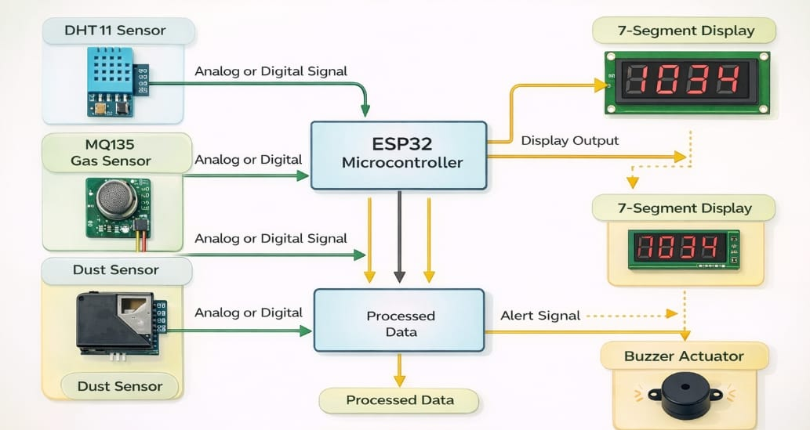
Working :

Slide 10
Conclusion :
• ESP32-based systems provide a low-cost and efficient solution.
• Suitable for educational, residential and small industrial use.
• Enables real-time monitoring of environmental parameters.
• Future improvements can include:
– IoT integration
– Better sensors
– Wireless communication
These systems have strong potential for smart environmental monitoring solutions.

Slide 11
References :
[1] V. A. A. Manimozhi et al., "Smart environmental monitoring system using LabVIEW," IJIRSET, 2017.
[2] E. Gertz and P. Di Justo, Environmental Monitoring with ESP , O’Reilly Media, 2012.
[3] K. A. Noordin et al., "Low-cost microcontroller-based weather monitoring system," IEEE, 2006.
[4] S. Choudhury et al., "ZigBee and Bluetooth based sensory data acquisition," Procedia Computer Science, 2015.
[5] F. Sheikh and L. Xinrong, "Wireless sensor network for environmental monitoring," Procedia Computer Science, 2014.

Slide 12
THANK YOU
Find out more at the PowerPoint Getting Started Center
(Click the arrow when in Slide Show mode)
Notes:
In Slide Show mode, click the arrow to enter the PowerPoint Getting Started Center.

